Slide 1
Operating Systems
Chapter 2 (c)
Operating System Structures
Hammad Afzal
hammad.afzal@mcs.edu.pk
Computer Science Department
College of Telecommunication Engineering
National University of Sciences and Technology

Slide 2
Chapter 2: Roadmap
Virtual Machines
Operating System Debugging
Operating System Generation
System Boot
Self Study

Slide 3
Virtual Machines
A virtual machine takes the layered approach to its logical conclusion. It treats hardware and the operating system kernel as though they were all hardware.
A virtual machine provides an interface identical to the underlying bare hardware.
The operating system host creates the illusion that a process has its own processor and (virtual memory).
Each guest provided with a (virtual) copy of underlying computer.
Self Study

Slide 4
Virtual Machines History and Benefits
First appeared commercially in IBM mainframes in 1972
Fundamentally, multiple execution environments (different operating systems) can share the same hardware
Protect from each other
Some sharing of file can be permitted, controlled
Commutate with each other, other physical systems via networking
Useful for development, testing
Consolidation of many low-resource use systems onto fewer busier systems
“Open Virtual Machine Format”, standard format of virtual machines, allows a VM to run within many different virtual machine (host) platforms
Self Study

Slide 5
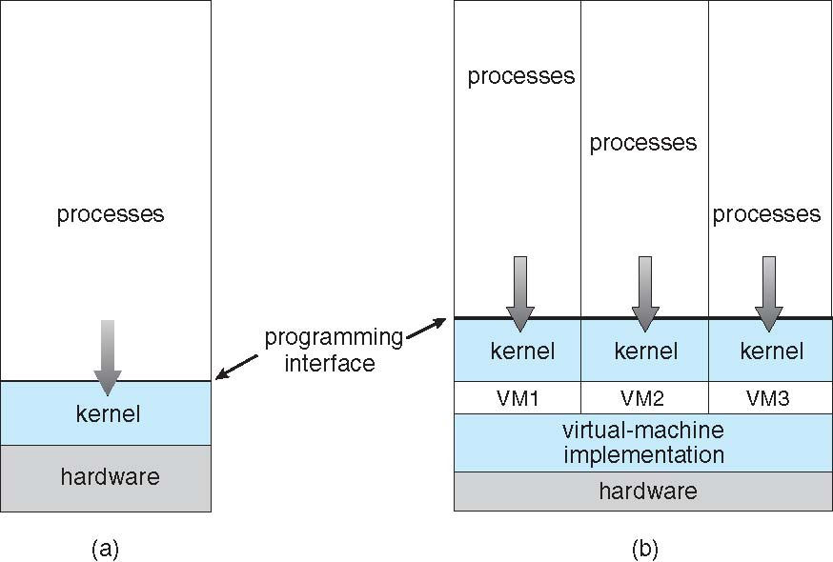
Virtual Machines (Cont.)
Self Study
(a) Nonvirtual machine (b) virtual machine

Slide 6
Para-virtualization
Presents guest with system similar but not identical to hardware
Guest must be modified to run on paravirtualized hardware
Guest can be an OS, or in the case of Solaris 10 applications running in containers
Self Study

Slide 7
Virtualization Implementation
Difficult to implement – must provide an exact duplicate of underlying machine
Typically runs in user mode, creates virtual user mode and virtual kernel mode
Timing can be an issue – slower than real machine
Hardware support needed
More support-> better virtualization
i.e. AMD provides “host” and “guest” modes
Self Study

Slide 8
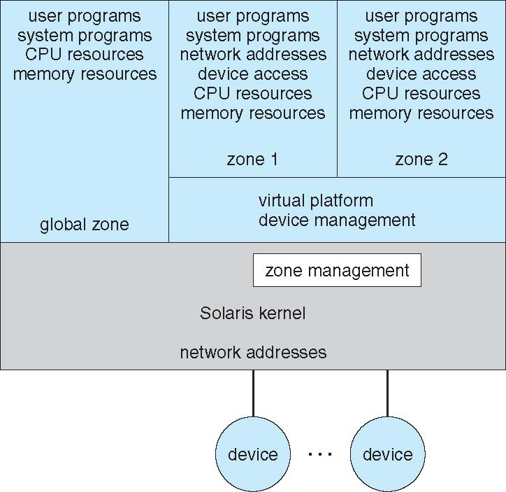
Solaris 10 with Two Containers
Self Study

Slide 9
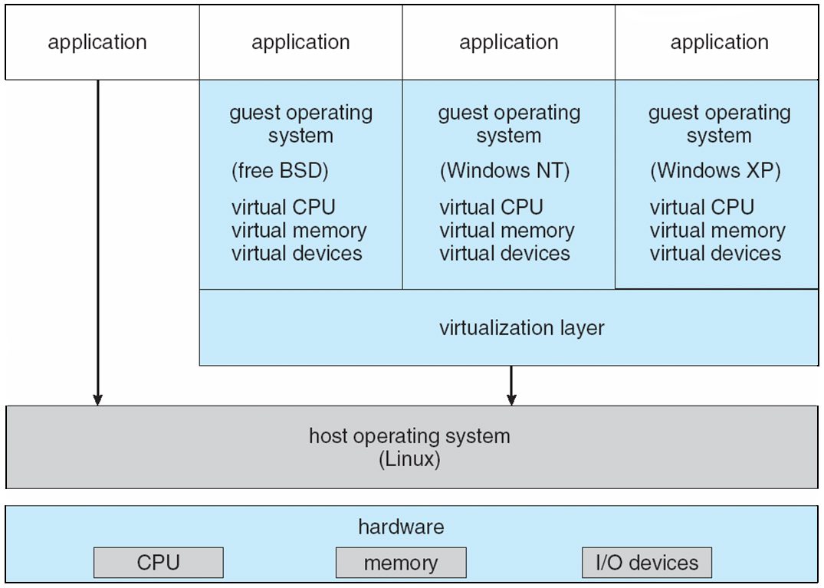
VMware Architecture
Self Study

Slide 10
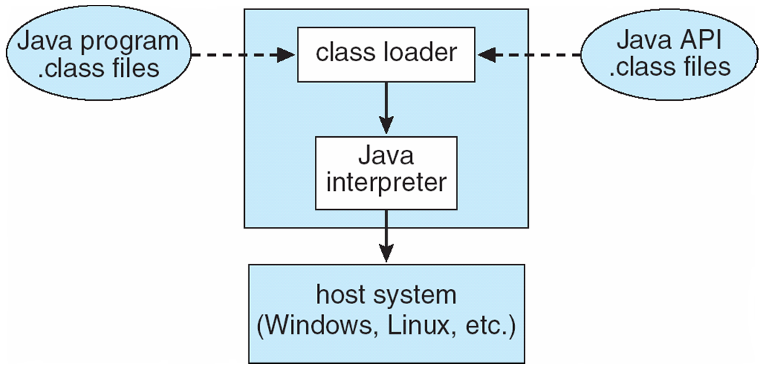
The Java Virtual Machine
Self Study

Slide 11
Operating-System Debugging
Debugging is finding and fixing errors, or bugs
Both in hardware or software.
Performance problems: Tuning by removing bottlenecks in processing.
Failure Analysis
OSes generate log files containing error information
Failure of an application can generate core dump file capturing memory of the process.
OS debugging is more complex due to size and complexity of kernel.
Kernel failure is called crash.OS failure can generate crash dump file containing kernel memory.
OS debugging takes different tools and techniques than user processes.
Self Study

Slide 12
Operating-System Debugging
Self Study
Performance Tuning
Code must be added to compute and display measures of system behavior.
OS produces trace listings of system behavior.
Interesting events are logged for later analysis (manually or automatically through analyzing programs).
Also user can view performance on run time.
Kernighan’s Law: “Debugging is twice as hard as writing the code in the
first place. Therefore, if you write the code as cleverly as possible, you are,
by definition, not smart enough to debug it.”

Slide 13
Operating System Generation
OSs are designed to run on any of a class of machines;
The system must be configured for each specific computer site for variety of peripheral configuration.
SYSGEN
Program obtains information concerning the specific configuration of the hardware system

Slide 14
Operating System Generation
SYSGEN
Reads info from
a given file,
or be provided info by system admin,
or directly probe hardware system.
Following info must be determined.
Info about CPU. (Instruction Set, Floating Point Arithmetic), multiple CPUs
Boot disk formation.
Available Memory (reference the memory location until fault is generated)
Devices available. How to address these devices, device interrupt number, device type and model etc
What is CPU scheduling algorithm, maximum number of processes

Slide 15
Operating System Generation
Three possible ways to use the generated info.
Recompile the Operating System.
Creation of tables and selection of modules from precompiled libraries.
All code is always part of system,
Selection of modules occurs at execution time rather than at compile or link time.

Slide 16
System Boot
Operating system must be made available to hardware so hardware can start it
Small piece of code – bootstrap loader, locates the kernel, loads it into memory, and starts it
Sometimes two-step process where boot block at fixed location loads bootstrap loader from disk.
When power initialized on system, execution starts at a fixed memory location (IR is loaded).
Firmware (ROM) used to hold initial boot code which is loaded in IR.

Slide 17
System Boot
Bootstrap program runs
Diagnostic test.
Initialize all aspects of system including registers, device controllers, memory.
System Disk or Boot disk
Separate partition that contains information about Booting.

Slide 18
End Chapter 2

